Slide 1
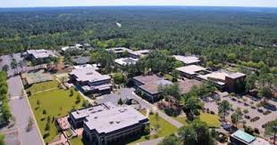
SANDHILLS CAMPUS TOUR
SCC Campus Tour Video

Slide 2
Career and College Promise (CCP)
Taking Community College Classes While Still in High School
SCC Information (PHS Website)
(Click on “Sandhills”)

Slide 3
Quick Facts
Partnership between NC, community colleges, and high schools to allow qualified students to take certain courses while still in high school.
Not all courses taught at SCC are available to high school students---only those in the CCP agreement.
Career and College Promise Information Website
Students must qualify, register, and apply for courses.

Slide 4
PURPOSE OF THE CAREER AND COLLEGE PROMISE PROGRAM
To allow students the chance to earn a greater number of college credits while still in high school.
To earn credits towards a specific associates degree while in high school.
To complete certifications while still in high school.
To experience a college class in a college setting.

Slide 5
Why consider Sandhills (SCC) while still in high school?
Classes are tuition FREE. (Some classes do have fees that you must pay Ex. Auto., Aviation, or Cosmo.)
Books or Online Book Codes are provided at no cost. Books/Codes are available for the 1st week of each semester, if a student doesn’t pick it up by then, they would be responsible for payment. They must be returned at the end of the semester.
Students can earn high school AND college credit.
Many credits can transfer directly to 4 yr colleges/universities. (Grade of C or higher)
Students get the experience of college while still at home.
Could allow you to qualify for a Sandhills Promise Scholarship.

Slide 6
Why consider SCC (cont.)
All classes can be used towards completion of a associate degree, credential/certificate.
Some classes may also count towards high school core class graduation requirements.
Allows/Forces students the opportunity to learn to be a self-advocate.
These are college courses that can build a good high school transcript.
The more college credits students have before they get to college the more flexibility they may have when they get there.

Slide 7
Why you may NOT want to consider SCC right now.
Advance Placement (AP) classes may be a better option for you AND your schedule can’t accommodate both.
Career Technical Education (CTE) classes at PHS may be a better option for you AND your schedule can’t accommodate both.
Other elective classes at PHS may be more important to you, Exs. Orchestra, Band, Debate. AND your schedule can’t accommodate both.
Calendars for each school differ. (Ex. Spring Breaks may be different, end dates, etc.)
Not quite ready yet for college. Please understand that this is ok.

Slide 8
Pitfalls…
Poor Attendance
Poor Time-Management
Miss Due Dates on Assignments
Don’t Check PHS/SCC email
Not Communicating with Professors
Don’t use supports in place: Tutoring Center, Writing/Math Labs, Parents, Counselors etc.
These issues will lead to being dropped from SCC classes!! Drops have negative consequences on both SCC and PHS transcripts as well as athletic eligibility and possible future financial aid.

Slide 9
3 Different Types of Courses at SCC
Transfer
2.8 UNweighted GPA Required or College Ready Scores on ACT/SAT
*General Education courses
*Weighted same as AP for your high school GPA
*Transfer to NC Public schools w/ final grade of A, B, or C
*Possibly transfer to out of state or private schools. (See each school for details on their credit transfer policies)
*A few courses will count as the graduation requirement needed in high school. Ex. 4th Math
Transfer Pathways

Slide 10
3 Different Types of Courses at SCC
Technical
2.8 UNweighted or Principal Permission w/2.5 unweighted GPA Required
*CTE type of courses
*Non-Weighted for your high school GPA
*Lead towards degrees and/or certifications at SCC
*Some courses do transfer to other colleges
*If a student completes a Technical Pathway they can participate in the SCC graduation ceremony. They don’t get a degree, but do get to participate.
Technical Pathways

Slide 11
3 Different Types of Courses at SCC
WorkForce/Continuing Education
2.8 UNweighted or Principal Permission w/2.5 unweighted GPA Required
16 Years Old
*Non-Weighted for high school GPA
*Lead towards certifications and/or immediate Job Ready skills/qualifications
Workforce/Cont. Ed. Pathways

Slide 12
PATHWAYS
Students can take courses from 1 Transfer Pathway (if qualified) and 1 Technical or Workforce Pathway OR Students can take classes from 2 separate Technical Pathways or Workforce Pathways OR 1 Workforce and 1 Tech pathway OR 2 Workforce Pathways.
**When looking at the Transfer Pathway class options, pay close attention to the restrictions for how many classes can be taken within each section of the pathway. Ex. In the Pathway leading to Associates of Sci. you can only take 2 classes and they must be from a different discipline.
See SCC websites for specific pathways.
Transfer Pathway Options
Technical Pathway Options
Workforce/Cont. Ed Pathway Options

Slide 13
Registration Steps
During registration students will complete a request sheet, naming the courses they want at SCC for the following year. (Ex. In Slides 14/15)
This sheet will be turned in when meeting with your Alpha Counselor and then me. Registration times vary for each student, but will be in March)
Course requests are sent over to SCC several months prior to the start of the semester and registered by staff at SCC. So, while I work with students throughout the year to request courses be aware that course requests made after registration lead to an increased chance of classes being filled.
Some classes are very popular or are very limited and will fill up prior to all students getting into requested courses.

Slide 14
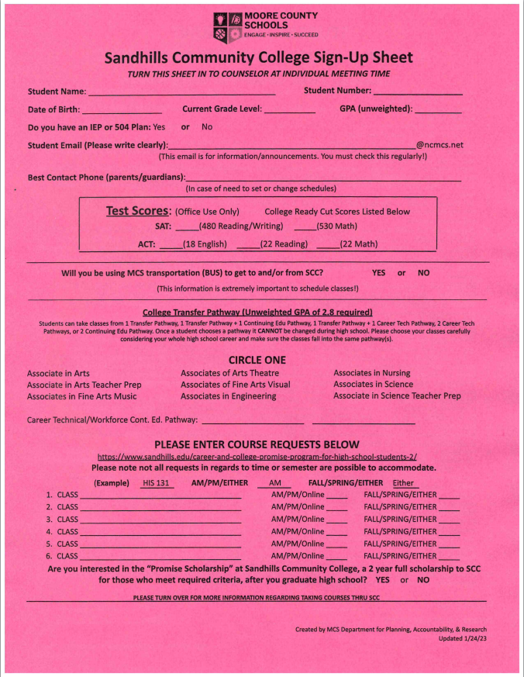

Slide 15
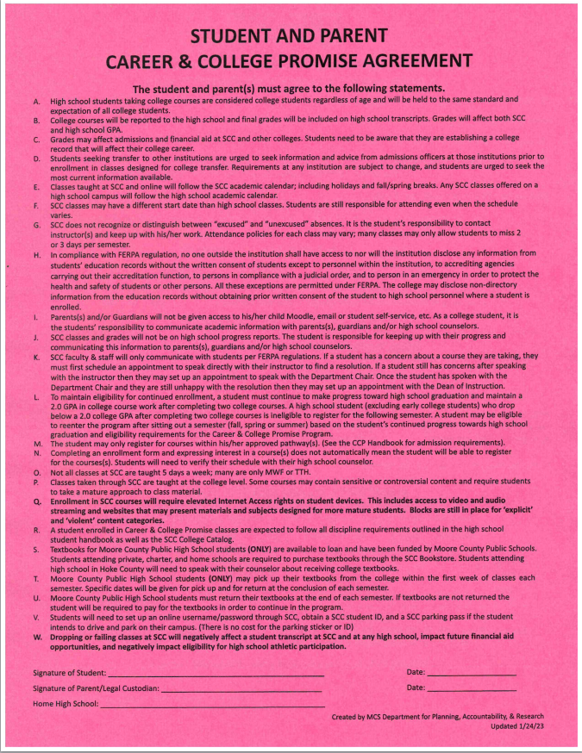

Slide 16
Registration Steps
Any interested student must complete an online application to Sandhills CC. Only 1 application must be completed throughout high school.
A student would complete the online application after selecting classes/pathway(s)
How To Complete Online Application Video
See Mr. Newton anytime for help. (Bring Chromebook and know your SSN)

Slide 17
What if I don’t drive?
We do have bus transportation:
Bus Leaves PHS at 8:40
Bus Comes back from SCC at 11:30
Bus Leaves PHS at 1:40
Not all classes will work with the bus schedule, but during registration I will ask if you need bus to help with scheduling.

Slide 18
Examples of Possible Schedules
The 3 slides that follow show sample schedules of students who have:
A) A student who takes a couple of SCC classes each semester at SCC and PHS
B) A student who takes both AP classes and SCC classes.
C) A student who took all remaining requirements the first half of their senior year and then took all SCC classes their 2nd half of their senior year.

Slide 19
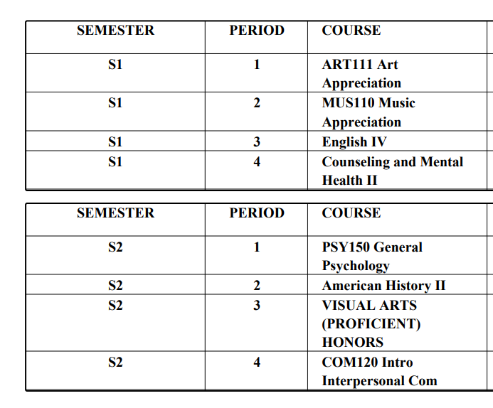

Slide 20
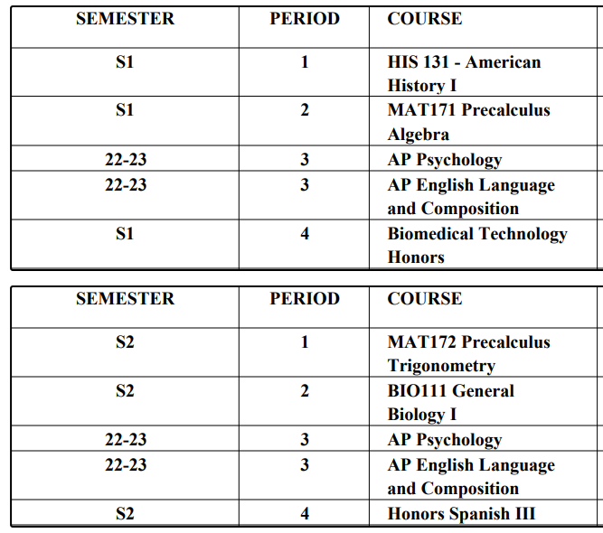

Slide 21
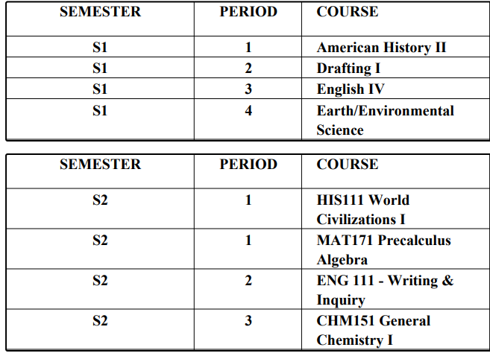

Slide 22
College Courses Under 3Hrs
If a college course is not at least 3 credit hours, that class will not receive high school credit.
These courses WOULD NOT count towards high school athletic eligibility.
These courses WOULD count towards Promise Scholarship eligibility.
Exs. HEA 112, MED 120, EGR 150, ACA 122, AER 112, AER 113

Slide 23
Promise Scholarship Criteria
Resident of Moore or Hoke Co.
High School graduate who will attend/take classes from SCC in the Fall semester after graduation.
Successfully complete minimum of 4 CCP courses while in high school. GPA of 2.0 or higher at SCC. (Some Workforce Classes are counted as multiple credits towards the Promise)
Completion rate of 67% or higher.
Complete enrollment requirements. application to SCC, scholarship application, FAFSA, and attend orientation.
Scholarship covers Tuition for 2 years!
LAST PAY SCHOLARSHIP

Slide 24
FAQ’s
Can I complete a full associates degree while in high school before I graduate? Career and College Promise is not designed as an early college program so it is not likely, but possible that students can fulfill high school graduation requirements and the 60+ hrs of college credits needed for an Associates Degree.

Slide 25
FAQ’s
Where and when are the classes taught? Classes are taught at SCC unless they are online. Online classes can be done at home or at PHS.
Are classes everyday or A/B? Classes are normally a few days a week, not everyday and not on the PHS A/B schedule. They are semester classes, not year long.

Slide 26
FAQ’s
If MCS calendar is different from the college calendar which one do I follow? Both, you will follow the SCC calendar for all your SCC classes and the MCS calendar for all your PHS classes. This could mean for example your spring breaks would be different.
What are the consequences for a dropped or failed class? All class drops and/or grades will be reported on your college AND high school transcripts if not dropped within the specified time period. This could affect college/high school GPA as well as completion percentage. It could also affect high school sports eligibility.

Slide 27
FAQ’s
How do I know if my class at SCC will transfer to the University I want to go to?
Transfer Pathway classes will transfer to all PUBLIC 4 year NC schools as well as many private schools in state (with grade of A, B, or C). Classes can and do also transfer to out of state schools, but those schools/classes must be looked at on an individual basis.
LINKS TO HELP WITH TRANSFER QUESTIONS
UNC System Transfer Resource
UNC System Course Equivalencies

Slide 28
FAQ’s
I am interested in the Promise Scholarship, can I take all 4 required classes 2nd semester of my senior year? While it may be possible it could also be hard to schedule all 4 classes in 1 semester. It can happen, but a student may need to be more flexible with their class requests.
How are the classes at SCC weighted? Transfer classes are given 1 extra quality point for their GPA = AP class weights. Career Technical/Cont. Ed. classes are not weighted.

Slide 29
FAQ’s
As a parent will the professors communicate with me or just the student?
The professors will only communicate with the students at the college level even though we here at PHS still consider them high school students. So, if there is an issue the student must initiate that conversation with the professor. You as the parent can help with the email or going through questions to ask the professor but all communication will go from the student to professor and back. I can also ask questions on the student’s behalf through my contact at SCC, Ms. Yarrington.

Slide 30
FAQ’s
If I have a 504 or IEP plan do I still get accommodations at SCC?
Yes, we would send a copy of your high school plan to SCC and they would develop an Accommodation Plan for SCC. It may include all or some of the same accommodations students receive at PHS. The student would share that plan with their professor(s).

Slide 31
FAQ’s
Can CCP courses be taken during the summer? Yes, after your 11th and 12th grade year classes that are “CCP” classes can be taken during the summer terms at SCC. Issues can arise with the timing of the end of our semester and the beginning of SCC’s summer term.

Slide 32
FAQ’s
When do I get a schedule from SCC?
March--Meet with PHS counselor and myself turn in request(s).
April—SCC registers students for fall classes. At that point students will have online access to view their SCC schedule—Students will be emailed instructions how to view that (PHS email)
End July/Early Aug.—Conflict Days at PHS to work on schedule conflicts
August 15th---1st day of Fall Semester FOR SCC
August ??th—1st day of Fall Semester FOR PHS
* Students could also choose or be scheduled for spring classes w/out having a Fall class.

Slide 33
Contact Information
Kimberly McMillan—Associate Dean of Instruction, CCP mcmillank@sandhills.edu (910) 246-4111
Elizabeth Yarrington- Director High School Relations for Moore County yarringtone@sandhills.edu (910) 695-3713
Jonathan Garrison- Director Sandhills Promise, Scholarships, Recruitment garrisonj@sandhills.edu (910) 695-3726
Rachel Mashburn - Sandhills Promise and HS Recruiter mashburnr@sandhills.edu (910) 246-5366
Jason Levister - Director Workforce/Continuing Education CCP levisterj@sandhills.edu (910) 695-3778
Joshua Newton—PHS CCP Counselor jnewton@ncmcs.org (910) 692-6554

